Slide 1

Examine the Effectiveness of Psychological Treatments in Alleviating Depressive Symptoms for Diabetes
Random Slope and Intercept Model
STAT 495
Bushra Abukarn

Slide 2
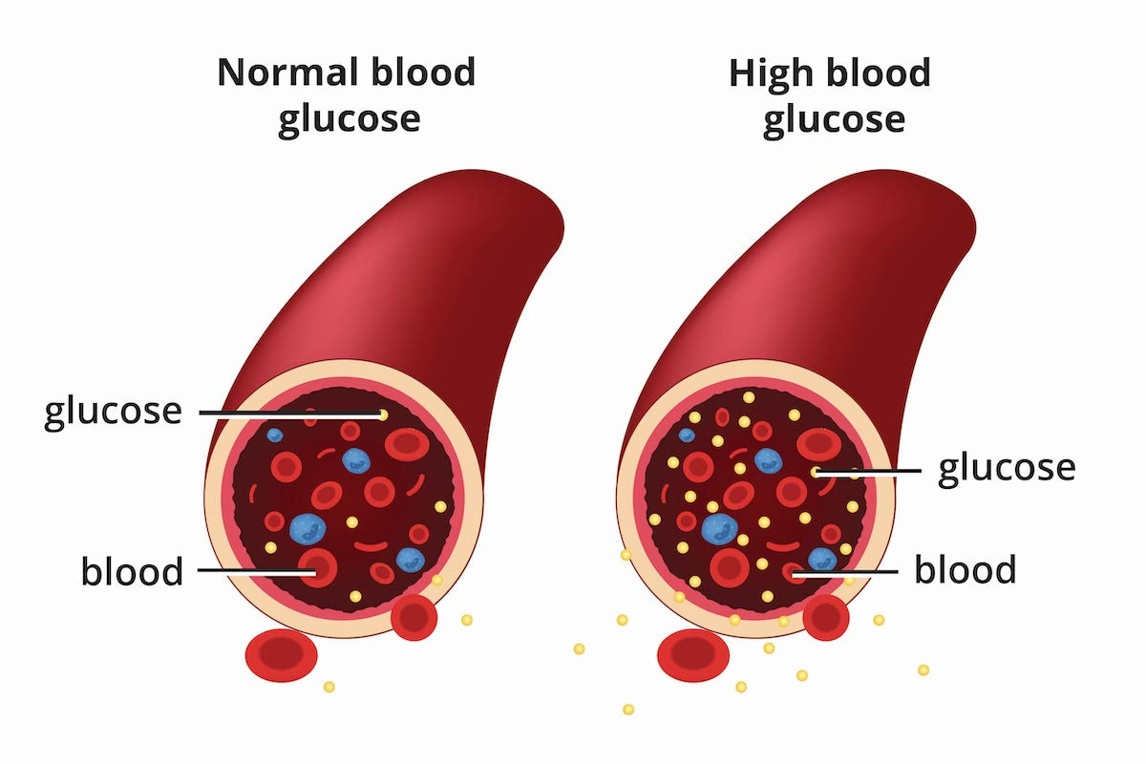
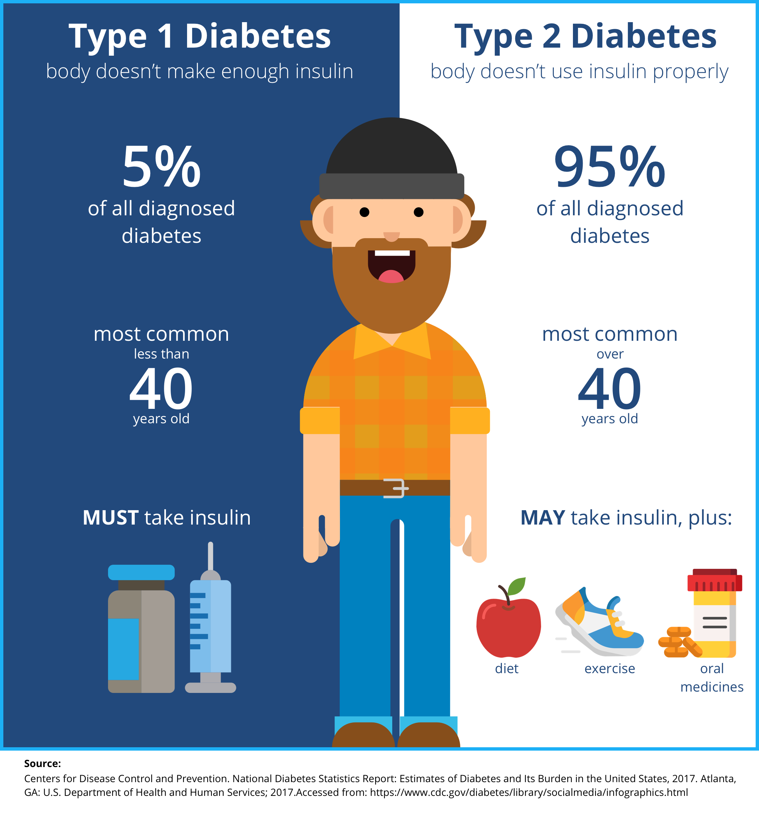
Diabetes: A chronic disease that affects the transformation of food into energy, breaking down most of the food in the body into sugar (glucose) and releasing it into the bloodstream. According to National Diabetes Statistics Report, 38.4 million people have diabetes (11.6% of the US population).
According to the Life Line Screening, the main difference between the two types of diabetes is:
Type I diabetes is a genetic disorder that often shows up early in life.
Type II is largely diet-related and develops over time.

Slide 3
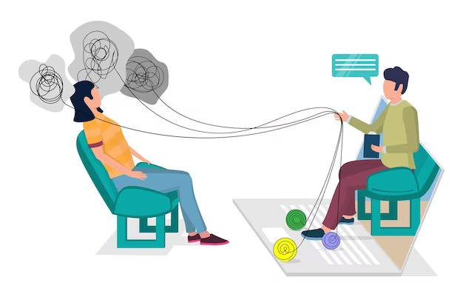
Psychological Treatments for Diabetes: Diabetes not only impacts the physical well-being of patients but also takes a toll on their mental health. A significant portion of individuals grappling with diabetes experience symptoms of depression.
Cognitive Behavioral Therapy (CBT):
Focuses on identifying and challenging negative thought patterns directly, aiming to change them into more positive and adaptive ones through structured exercises and homework assignments.
Mindfulness-Based Cognitive Therapy (MBCT):
Integrates mindfulness practices with cognitive therapy techniques. It encourages individuals to observe their thoughts and emotions without judgment, and acceptance to prevent relapse and manage symptoms.

Slide 4
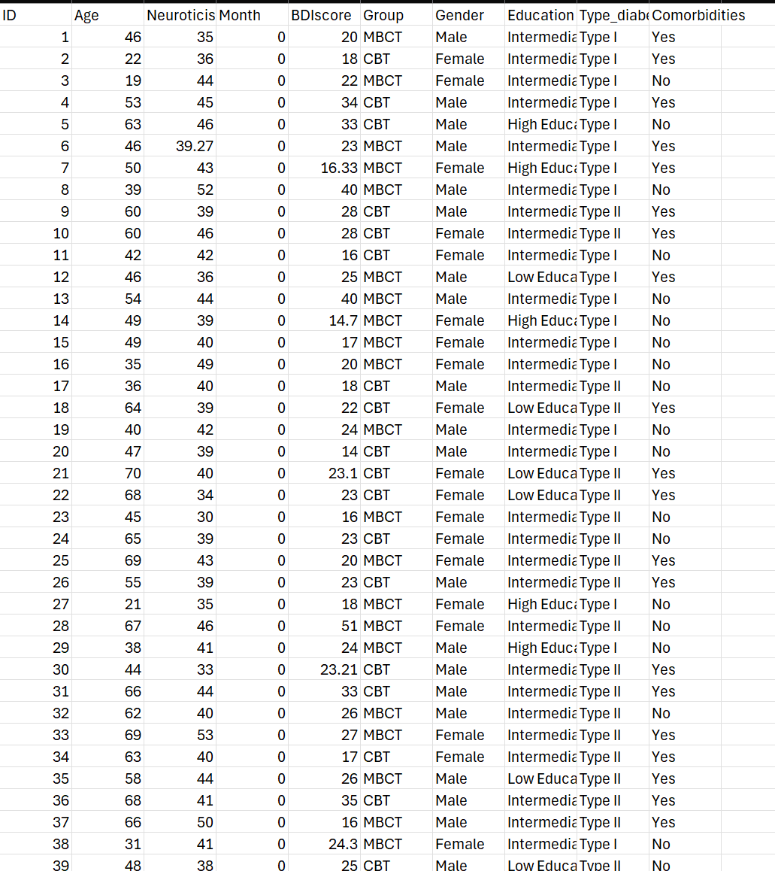
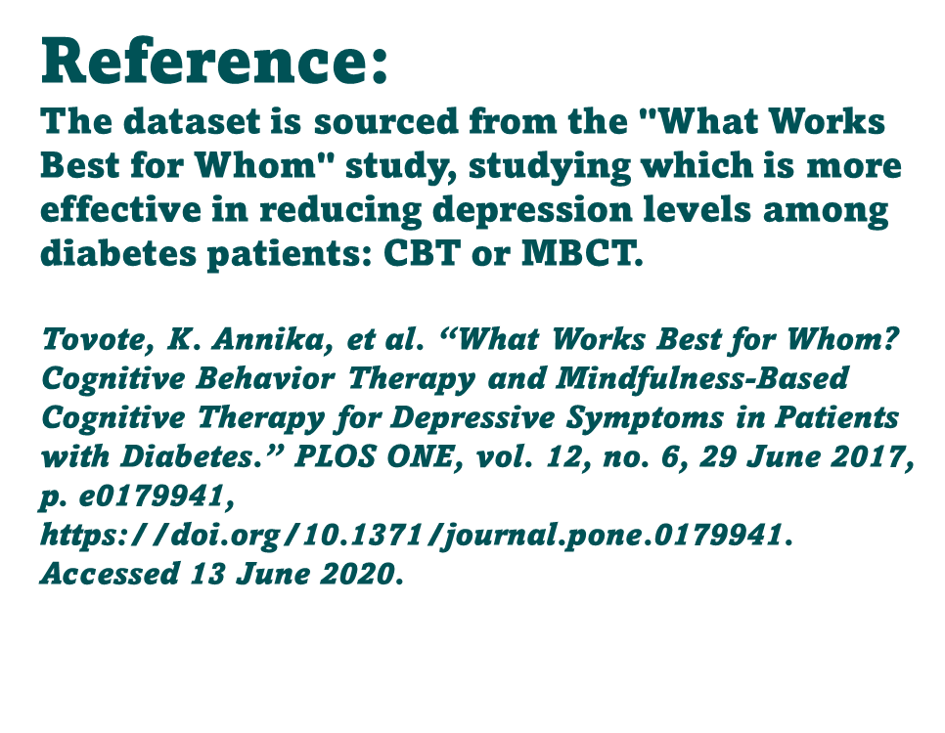
Dataset: In this longitudinal dataset patients were followed for a year, and BDI score (severity of depressive symptoms) were measured at pre-treatment, post-treatment, and at the 9-month follow-up. The response variable is the BDI score where the predictors include Group of treatment, Gender, Age, Education level, Type of diabetes, Comorbidities, and Neuroticism.

Slide 5
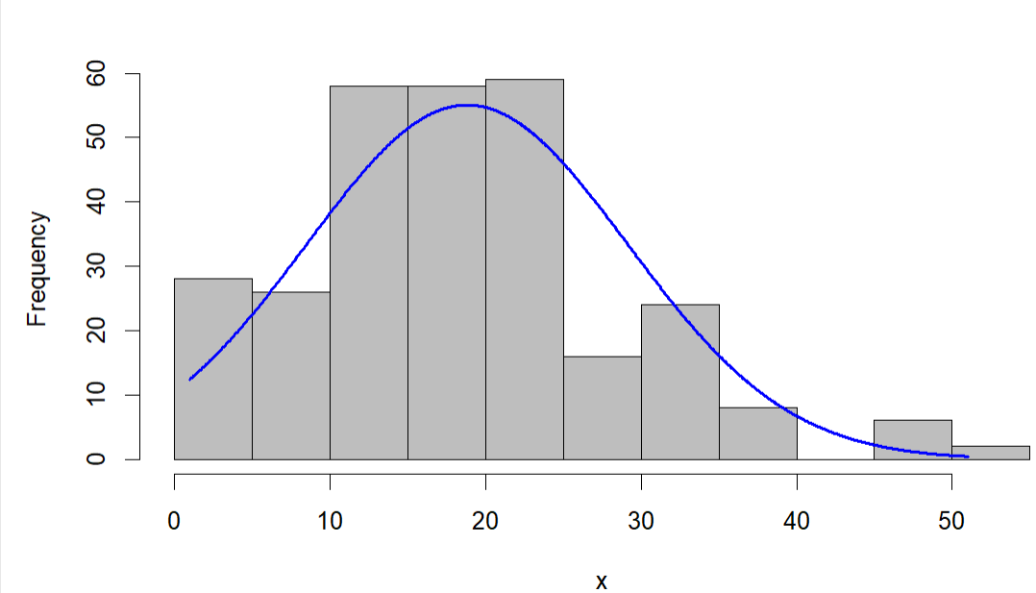
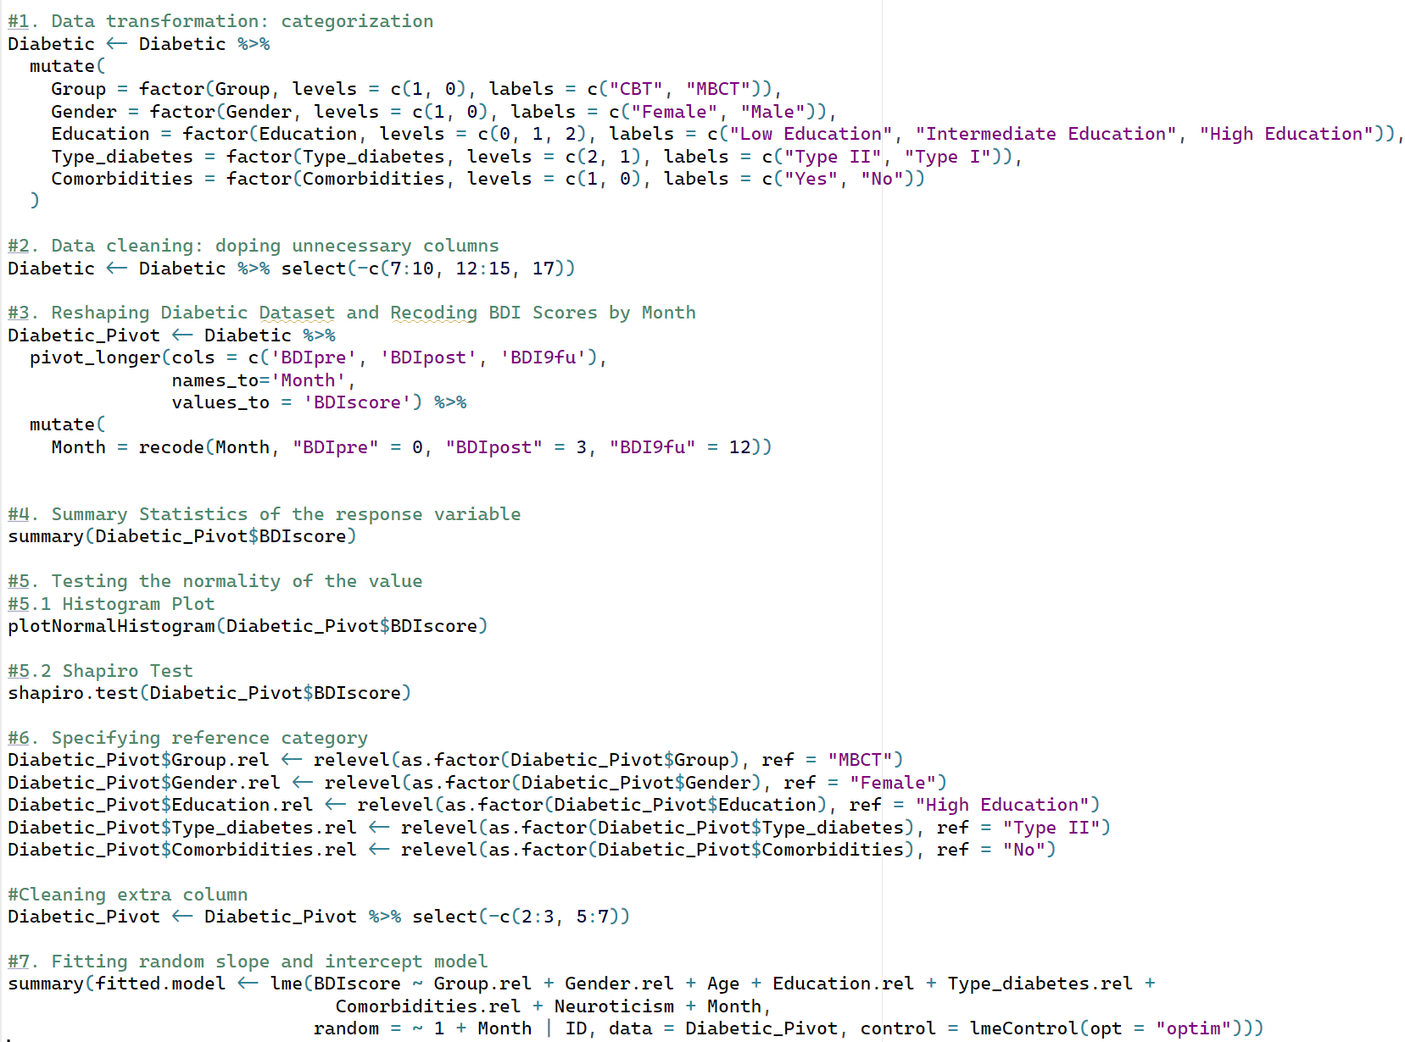

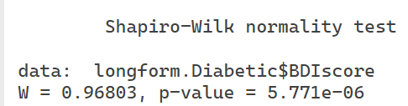
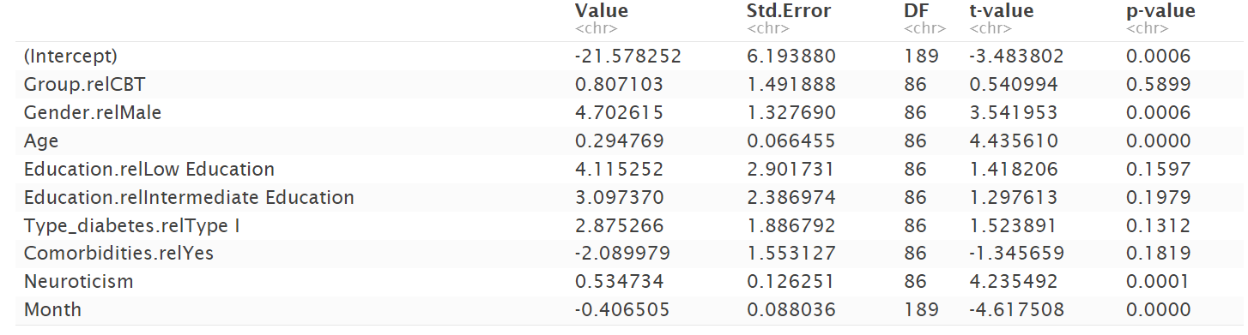

R (programming language):

Slide 6
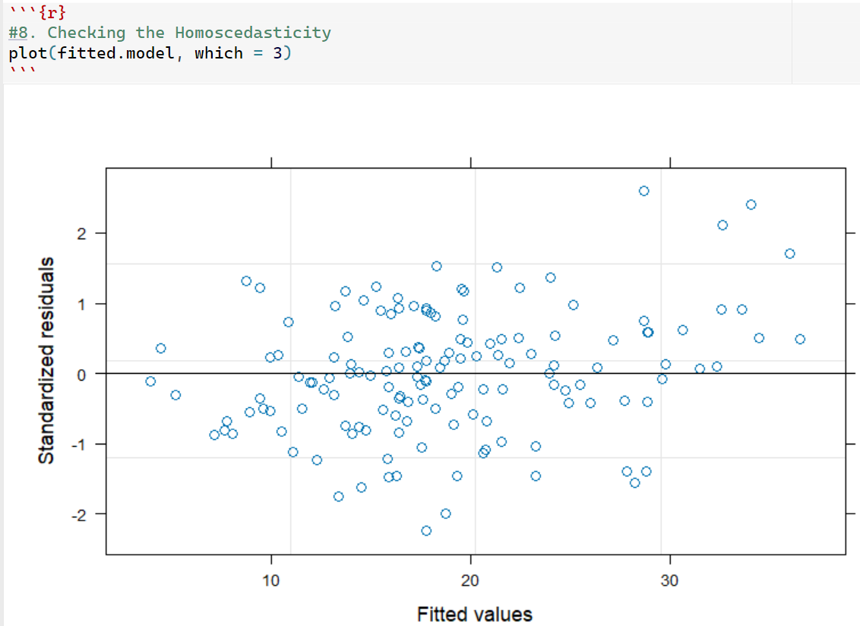
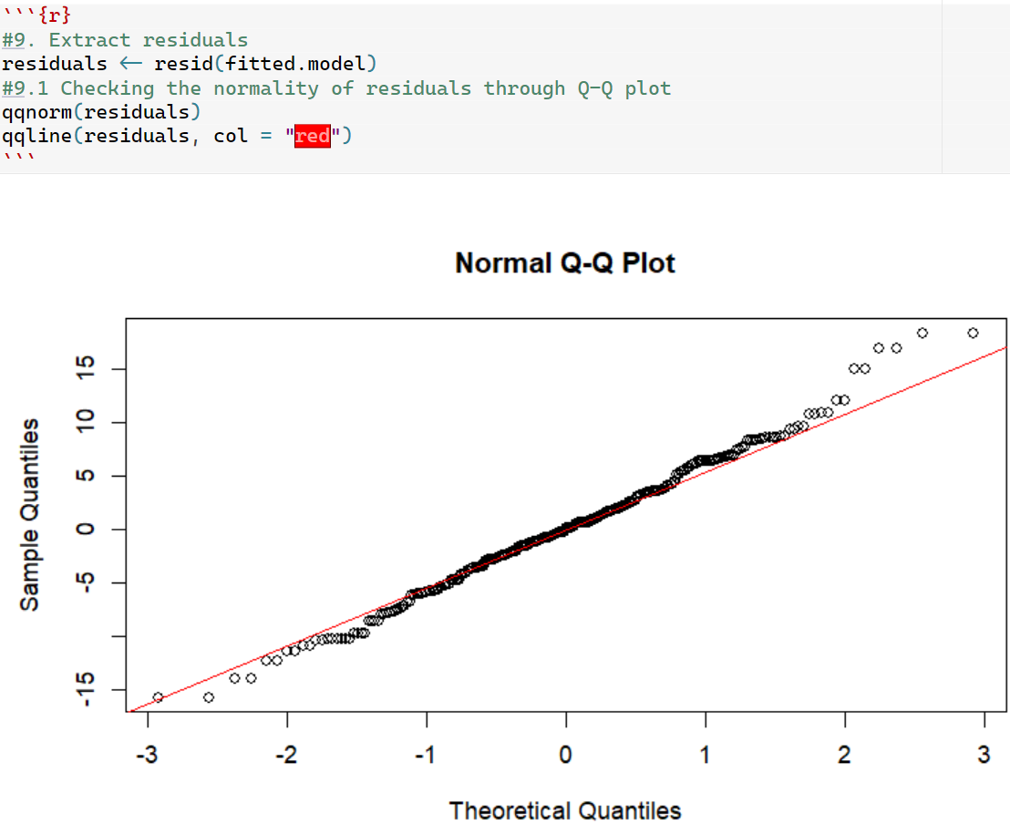
Normality & Homoscedasticity
This is a residuals vs. fitted values plot for the Linear Mixed-Effect model, which shows the standardized residuals on the y-axis and the fitted values (predicted values) on the x-axis.
Overall, the plot suggests a reasonably good fit, with the residuals scattered randomly around zero, indicating that the model captures the main patterns in the data.

Slide 7

Fitted Model & Interpretation:
Ê(BDI) = -21.578252 + .807103 CBT + 4.702615 Male + .294769 Age + 4.115252 Low Education + 3.097370 Intermediate Education + 2.875266 Diabetes Type I - 2.089979 Comorbidities + .534734 Neuroticism - .406505 Month. σ = 7.07.
For males, the estimated average BDI score (severity of depressive symptoms) is 4.702615 points higher than for females.
Additionally, for every additional year of age, the estimated average BDI score increases by 0.294769 points.
Moreover, as the neuroticism level increases by one unit, the estimated average BDI score increases by 0.534734 points.
Conversely, the estimated average BDI score decreases by 40.6% for every three months of psychological treatment.
The range of standardized residuals is approximately [−2.24,2.59], with a median close to zero. This distribution of residuals is relatively symmetric around zero, which is a good indication of a well-fitted model. The residual error of 7.07 suggests some variation remains unexplained at the individual level.

Slide 8
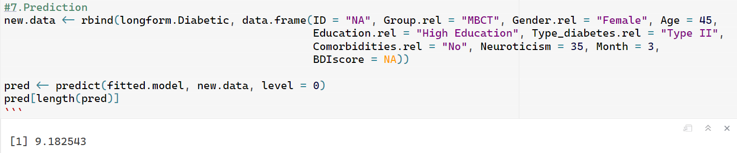
Prediction BDI Score:
Here I used the model to predict the BDI score of a 45-year-old female in the MBCT post-treatment period, dealing with type II diabetes, who has a high level of education and no comorbidities. Her neuroticism level is 35.
R (programming language):
By hand:
-21.578252 + .294769 (45) + .534734 (35) - .406505 (3) =9.181828

Slide 9

Conclusion:
Based on the results we obtained, we can conclude that psychological treatments have a significant impact on alleviating depressive symptoms in diabetic patients over time. However, we can also conclude that there is no significant difference between the CBT treatment and MBCT treatment for diabetic patients, as the p-value of the CBT treatment is greater than 5%. The "What Works Best for Whom" study found that both therapies, CBT and MBCT, helped reduce depression in diabetic patients, which supports the results we obtained.

Slide 10

Thank you to my professor Dr. Olga and to my wonderful classmates

